Slide 1
Course Outline
1 Getting Started
2 Thinking in Object-Oriended Progarmming
3 The C in C++
4 The basics of C++
5 More advanced topics of C++

Slide 2
The C in C++
3.1 Class
3.2 Composition
3.3 Operator overloading
3.4 Automatic type conversion
3.5 Inheritance
3.6 Polymorphism & Virtual Functions

Slide 3
3.1 Class
Object
Object = Entity
Object = Attributes + Service
Data
Operations

Slide 4
Abstraction: From the problem space to the solution one.
Abstraction data type( Class )
The ability to package data with functions allows you to create a new data type. This is often called encapsulation. This new data type is called “abstraction data type”.
Problem space
map
Solution space

Slide 5
C++ Access Control
C++ introduces three new keywords to set the boundaries in a structure: public, private, and protected.
public: means all member declarations that follow are available to everyone. public members are like struct members.
private: means that no one can access that member except you, the creator of the type, inside function members of that type。
is a brick wall between you and the client programmer; if someone tries to access a private member, they’ll get a compile-time error.

Slide 6
protected: acts just like private, with one exception that we can’t really talk about right now: “Inherited” structures (which cannot access private members) are granted access to protected members.

Slide 7
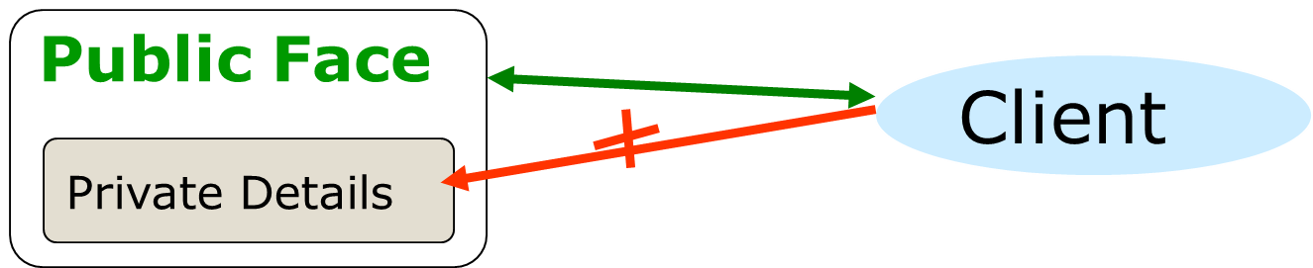
Information hiding
Information hiding is a design strategy
-Hide details that may change
-Expose interfaces that will be constant (relatively)

Slide 8
How to define a class
Declarations part(head file)
class class-name {
private: private member
public: public member
}；
Data member
Member function

Slide 9
Implementation part(member function definition)
[inline] type className::function_name( parameter list)
{
function body
}
unit three\complex\simple complex\

Slide 10
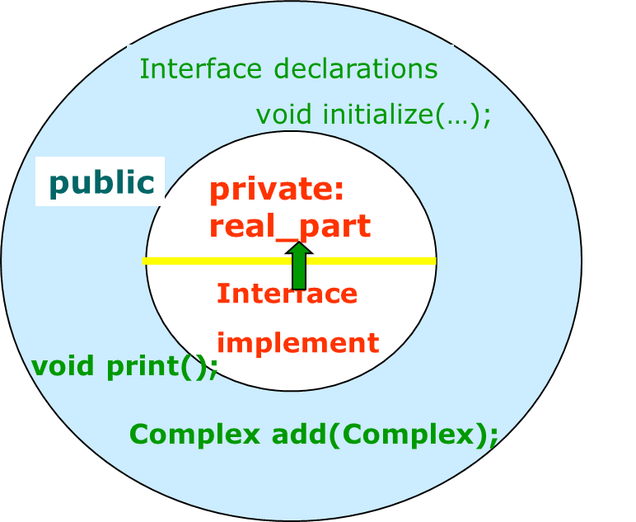
Control Access
Members see all members

Slide 11
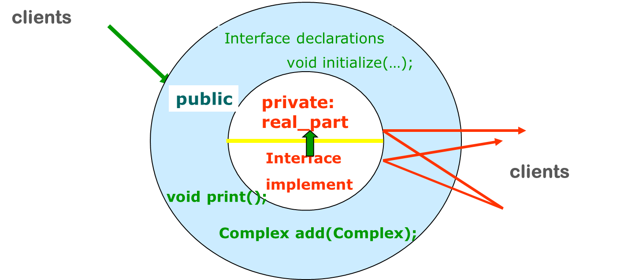
C++ access control
Clients only access public members

Slide 12
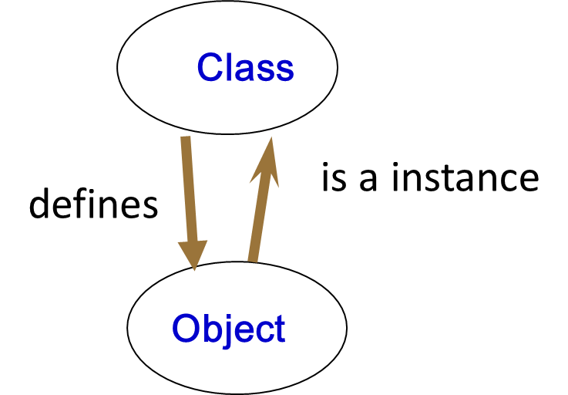
Using class
Create Object(instance)
Complex c; // just as you create a float by saying
float f;
Object VS Class
-Object (Complex )
Represent things, events, or concepts
Respond to messages at run-time
-Class (Complex class)
Define properties of instances
Act like types in C++

Slide 13
Using Object
Send messages to them
complex c;
c.print();

Slide 14
Object pointer
complex a(1.1,2.2);
complex *p = &a;
p->print(); //Make the call using the object pointer
a.print(); // Make the call using the object name

Slide 15

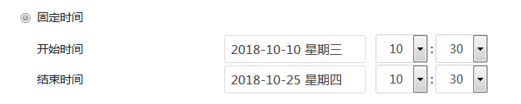

Slide 16
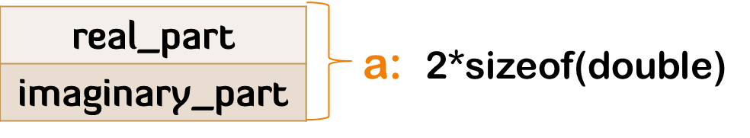
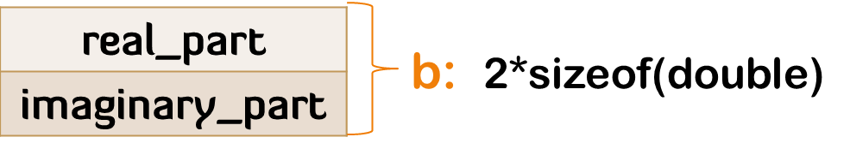
How to create an object(instance)?
当创建complex类的对象a时，以complex类定义为样板建立a的相应的数据成员，但它并不为对象a从complex类定义中拷贝所定义的操作代码。也就是： complex类定义中的成员函数代码存储在某块公用的存储空间中，供该类的所有对象共享---代码共享。
Complex a, b;

Slide 17
this pointer
this： the address of the object for which it is being called.
complex a;
分两步：
首先，编译器为a分配sizeof(Complex)大小的存储空间，得到this值(为a对象的起始地址),但此时this指向的是一片未初始化的空间。
第二步，调用构造函数Complex()来初始化this指向的区域，也就是对象a。

Slide 18
How big is an object(instance)?
The answer is “about what you expect from a C struct.”
The size of a object is the combined size of all of its members.
You can determine the size of an object using the sizeof operator.

Slide 19
Initialization & Cleanup
void complex::initialize(double rp,double ip)
{
real_part = rp;
imaginary_part = ip;
}
complex c; //declaring object
c.initialize(1.1,2.2); //initializing object，forget??
c.print(); //using object

Slide 20
Constructors
A constructor is a special member function
Same name as its class
No return type
Invoked implicitly when instance is created
can be overloading

Slide 21
How to cleanup an object
In C/C++, the data that storaged in stack and static store are released by system
int i; //global object
static int k; //static global object
int fun(int i)
{
int temp = i*2; //local object
static int g; //static local object
return temp;
}

Slide 22
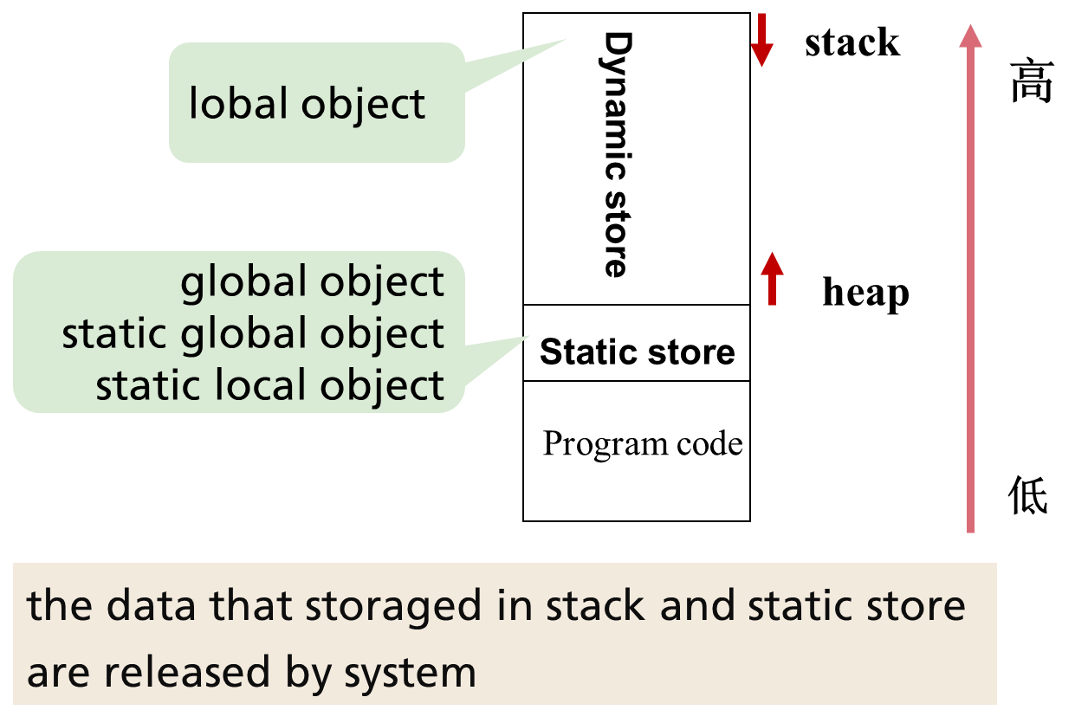

Slide 23
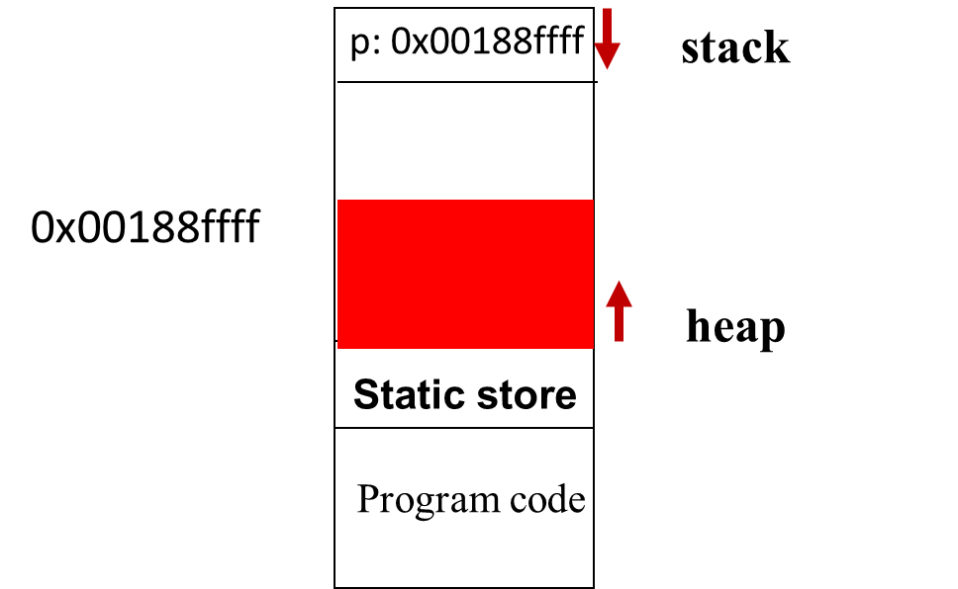
In C/C++:the data that storaged in heap are released by programmer
int main()
{
char* p = (char*)malloc(200);
…
free(p); // released by programmer
File fp = fopen(“myfile.txt”);
…
fclose(fp); //released by programmer
}

Slide 24
void main()
{ complex a(1.1, 2.2);
complex *p = new complex(1.1 , 2.2);
free(p);
}
a and p itself are released by system
Anonymity complex in heap is released by programmer

Slide 25
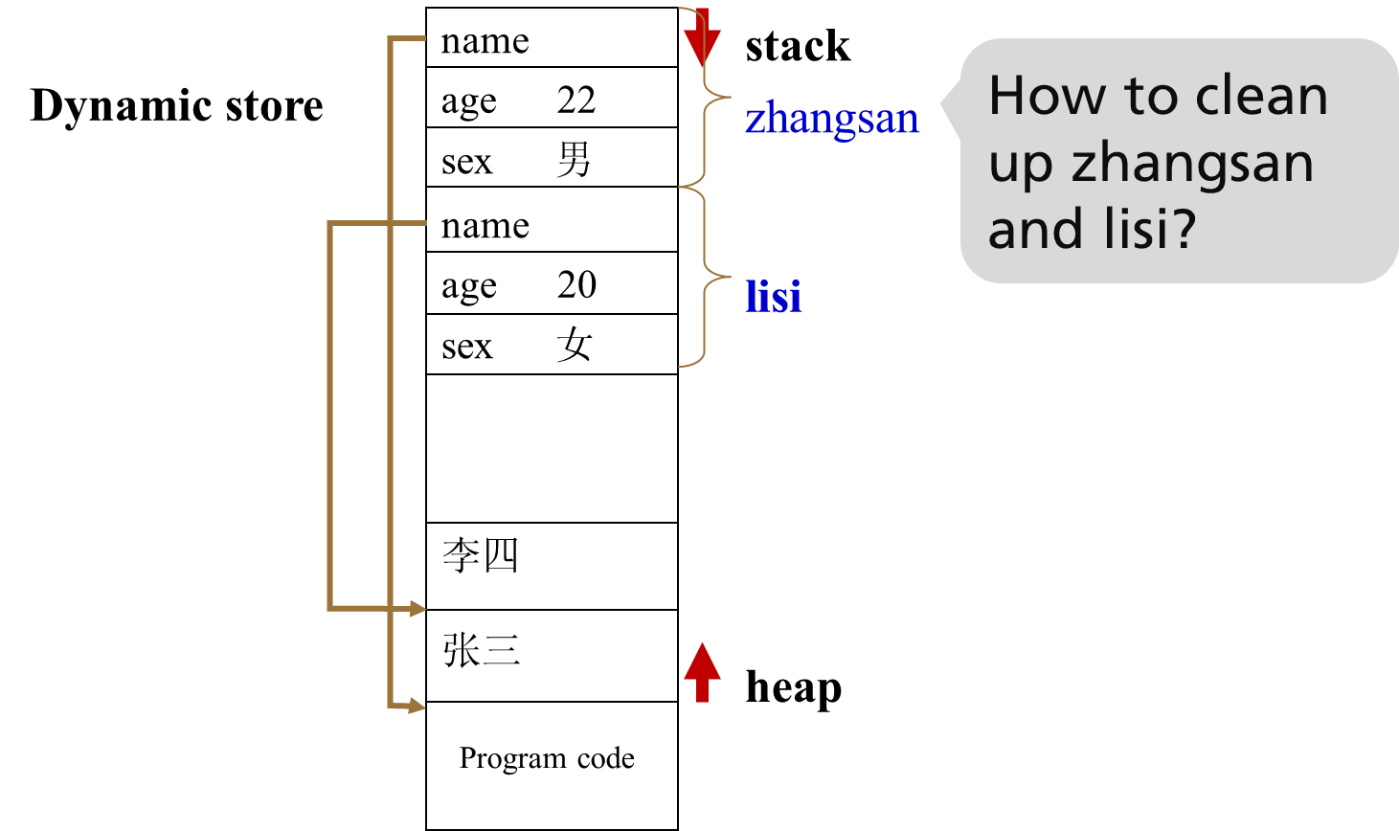
unit three：student.dsw

Slide 26
How to cleanup an object
Student::~Student() //destructor
{
if (name != NULL)
free(name);
}
void main()
{
Student zhangsan("张三",22,"男");
}
destructor is called automatically by the compiler when the object goes out of scope.

Slide 27
Destructor
Called when an instance is deallocated
Name is ~Classname
Does not take any arguments
Does not declare a return type
Can’t be overloading

Slide 28
Default constructor and default destructor
Requires the user to re-write destructor in complex class ?
class Student{
private:
char name[20];
short age;
char sex[3];
};
requires to re-write destructor?

Slide 29
Object Lifetime
Local lifetime
Global lifetime
Local object
Global object
Static local object
Static global object
Where and when the constructor / destructor gets called ?
unit three/object_scope

Slide 30
item18: to make the class interface is complete and minimal（Effective C++）
When designing a class, as a rule, an intact interface includes:
constructor(several?)
destructor(Need to do?)
operetor=
access functions(set or get private data member) etc.
get方法可以控制返回给客户的数据格式。
set方法可以检查对private变量值进行修改的企图，确保新值对那个数据成员来说是合适的、完整的、一致的。

Slide 31
它使程序从软件工程的角度看显得更具有吸引力。
set和get方法虽然提供了对private数据的访问渠道，但通过控制这些访问器的实现，就能控制客户代码能对数据进行什么操作。
能在类的客户面前隐藏数据成员的内部表示方式。因此，如果数据的表示方式发生改变（通常是为了减少所需的存储空间，或者为了改进性能），那么只需修改方法的实现，客户端的实现则无需更改---只要方法提供的接口予以保留。

Slide 32
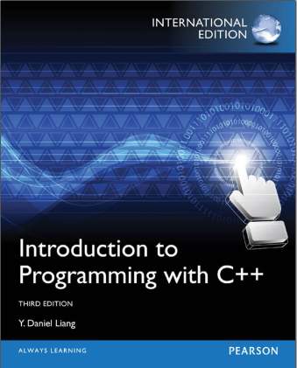
Chapter 9 Objects and classes 9.4 Constructors 9.5 Constructing and Using Objects
Chapter 11 Pointers and dynamic memory management
11.11 The this Pointer
11.12 Destructors

Slide 33
The C in C++
3.1 Class
3.2 Composition
3.3 Operator overloading
3.4 Automatic type conversion
3.5 Inheritance
3.6 Polymorphism & Virtual Functions

Slide 34
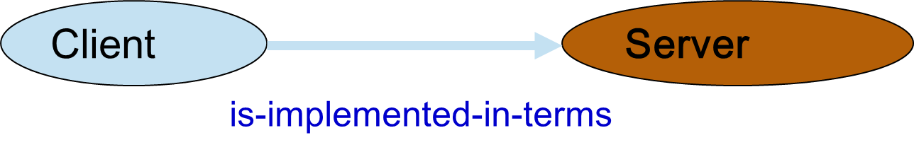
3.2 Composition
In C++, Code Reuse
-instance reuse
-object member---entrust
-inheritance
trhee/Composition/consign1.cpp~consign3.cpp

Slide 35
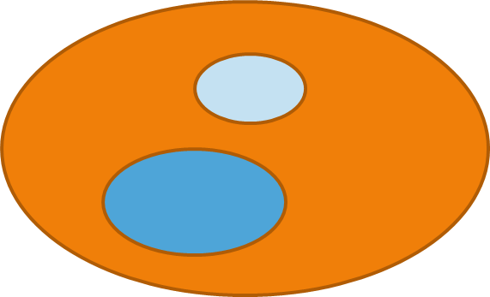
Composition-Member Object
Sub object
-When an object is created, the compiler guarantees that constructors for all of its subobjects are called.
Memberwise initializing
three/Composition/object member.cpp

Slide 36
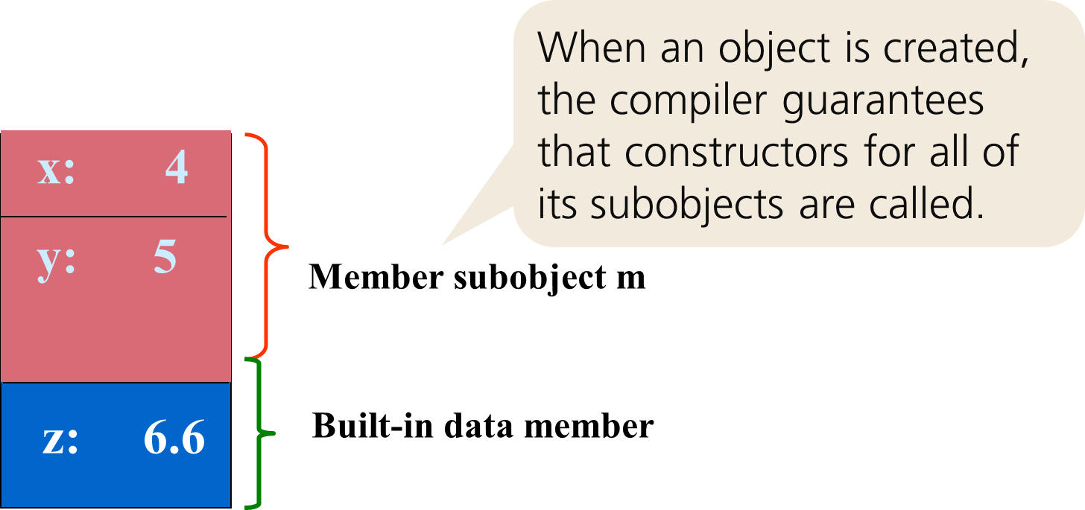

Slide 37
class B{
private: float z;
A m; //member subobject
public: B(int r1,int r2,float r)：m(r1,r2)
{ z = r; }
};
Constructor initialization list
B b(1,2, 3.3);
call A(1,2)-->call B(1,2,3.3)

Slide 38
class B{
private: float z;
A m; //member subobject
public: B(int r1,int r2,float r)：m(r1,r2)
{ z = r; }
B() {z = 0.0;}
};
B( ) : m( ) //leave out：m()
{ z = 0.0;}
B b;
call A()-->call B()

Slide 39
About Constructor initialization list
This is especially critical when initializing const and reference data members because they must be initialized before the function body is entered.
To make the syntax consistent, you are allowed to treat built-in types as if they have a single constructor, Thus, you can say:

Slide 40
class C{
private:
int n;
const int cint; //const data member
int& rint; //reference data member
A m; //object member
public:
C(int param) : n(param), cint(5), rint(n), m(…)
{ }
};

Slide 41
Member object initialization sequence is consistent with their declared order in the class. has nothing to do with listed order in the constructor initialization list.
to see:<effective C++>item 13
Use Constructor initialization list if you can.

Slide 42
Chapter 10 object-oriented thinking 10.8 Object Composition

Slide 43
The C in C++
3.1 Class
3.2 Composition
3.3 Operator overloading
3.4 Automatic type conversion
3.5 Inheritance
3.6 Polymorphism & Virtual Functions

Slide 44
3.3 Operator overloading
一般说来，C++ 预定义类型(char、int、float等)的操作用运算符来表示，其调用形式是表达式，中缀性式：a+b ，前缀形式：++a，后缀形式：a++。用户定义的类型的操作则用函数表示，对它采用显式调用。为了使用户定义的类型与系统预定义类型相一致，也允许对用户定义的类型使用运算符来表示操作，如set1+set2，matrix1*matrix2。这种一致性还表现在可以为用户定义的类型提供初始化、赋值以及转换规则等。

Slide 45
Syntax
Defining an overloaded operator is like defining a function, but the name of that function is operator@, in which @ represents the operator that’s being overloaded. The number of arguments in the overloaded operator’s argument list depends on two factors:
成员函数版_complex
友员函数版_complex

Slide 46
Whether it’s a unary operator (one argument) or a binary operator (two arguments).
Whether the operator is defined as a global function (one argument for unary, two for binary) or a member function (zero arguments for unary, one for binary – the object becomes the left-hand argument).

Slide 47
Member function VS non-member function
Declare non-member functions when type conversions should apply to all parameters.
[若所有参数皆需类型转换，请为此采用non-member函数重载]

Slide 48
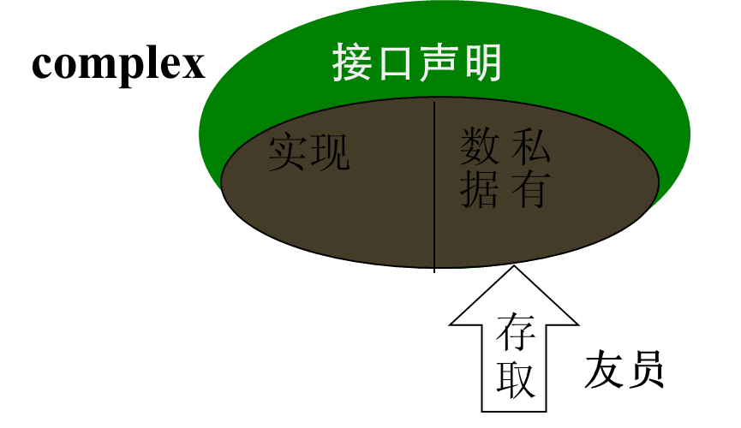
friend
C++中的友员相当于为封装隐藏这堵不透明的墙开了一个小孔，任何该类的朋友可以通过这个小孔窥视该类的私有数据。
注意友员函数与成员函数的区别：友员函数在类中声明，但不是该类的成员函数，不能通过this指针调用。

Slide 49
使用全局友员函数是不恰当的。它破坏了面向对象程序设计风格的一致性，使数据封装性受到削弱，导致程序的可维护性变差。在以下情况发生，考虑使用友员函数：
-在类的设计中没有为类定义完整的操作集，将友员函数作为对类的操作的一种补充形式。
-考虑运行效率。
Friend
-友元函数 -友元成员函数 -友元类

Slide 50
Overloadable operators
Although you can overload almost all the operators available in C, the use of operator overloading is fairly restrictive. In particular, you cannot combine operators that currently have no meaning in C (such as ** to represent exponentiation), you cannot change the evaluation precedence of operators, and you cannot change the number of arguments required by an operator. This makes sense – all of these actions would produce operators that confuse meaning rather than clarify it.

Slide 51
Operators you can’t overload
There are certain operators in the available set that cannot be overloaded. The general reason for the restriction is safety. If these operators were overloadable, it would somehow jeopardize or break safety mechanisms, make things harder, or confuse existing practice.
· * :: :? sizeof

Slide 52
Unary Operators
to overload all the unary operators, in the form of both global functions (non-member friend functions) and as member functions.
Binary Operators
C12: Byte.cpp 成员函数版/Unary.cpp 友员版
C12:Integer.h/Integer.cpp/IntegerTest.cpp友员版 Byte.h成员函数版

Slide 53
Basic guidelines
In some of the previous examples, the operators may be members or non-members.
Which should I choose?
In general, if it doesn’t make any difference, they should be members, to emphasize the association between the operator and its class. When the left-hand operand is always an object of the current class, this works fine.

Slide 54
However, sometimes you want the left-hand operand to be an object of some other class. A common place you’ll see this is when the operators << and >> are overloaded for iostreams. Since iostreams is a fundamental C++ library, you’ll probably want to overload these operators for most of your classes, so the process is worth memorizing

Slide 55
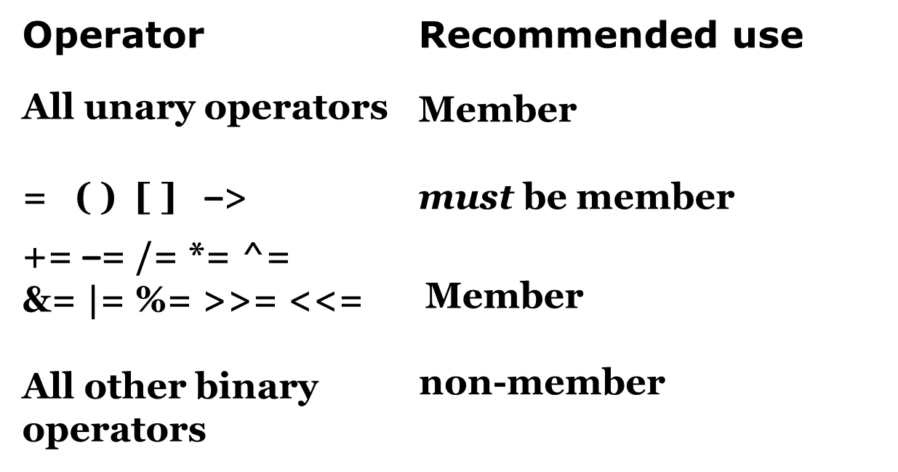
Suggests

Slide 56
Unusual operators overloading
Increment & decrement (++ / - -)
在C++中，单目前缀增（减）和后缀增（减）都用++(--)运算符来表示，编译器为了区分它们规定：后缀增（减）函数应带有一整型量，这种参量仅仅用来区分前后缀，调用时，不必显式给出，它的缺省值为0。
前缀++： ++a <==> a.operator ++() //前缀增函数
后缀++： a++ <==> a.operator ++(0) //后缀增函数
前缀--： --a <==> a.operator --()
后缀--： a-- <==> a.operator --(0)
operator overloading/increment decrement/counter

Slide 57
[] = () -> must be overloaded as a member function
二目运算符[ ]，通常用它来定义对象的下标操作，第一个操作数必须是该类的对象。故只能重载为类的成员对象。
Three/operator=/int-Array.cpp

Slide 58
Assignment operator = overloading
Because assigning an object to another object of the same type is an activity most people expect to be possible, the compiler will automatically create
className& className::operator=(const className&) ;
Default Policy: bitcopy
If you don’t make one. The behavior of this operator mimics that of the automatically created copy-constructor;

Slide 59
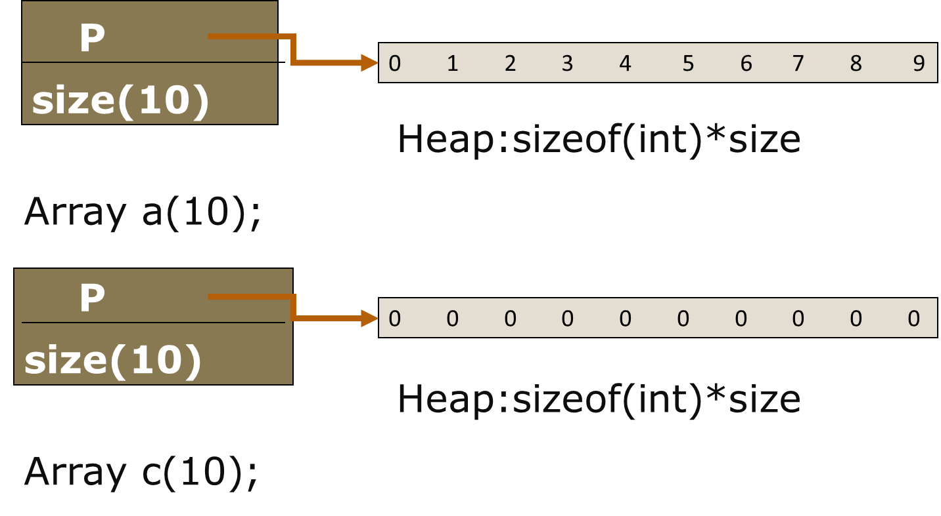

Slide 60
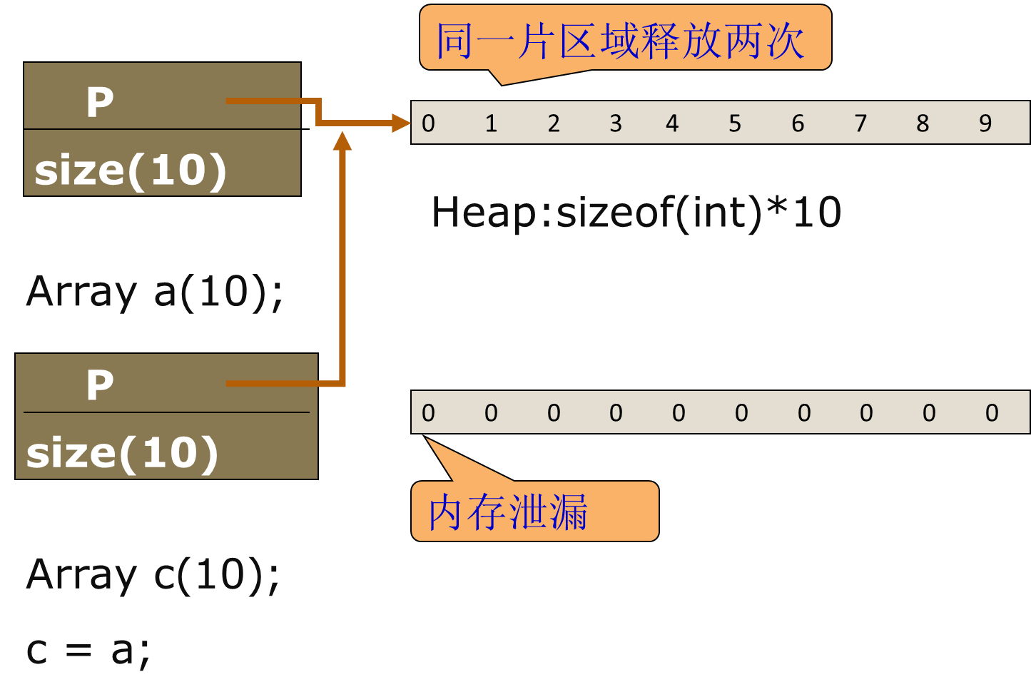

Slide 61


Slide 62
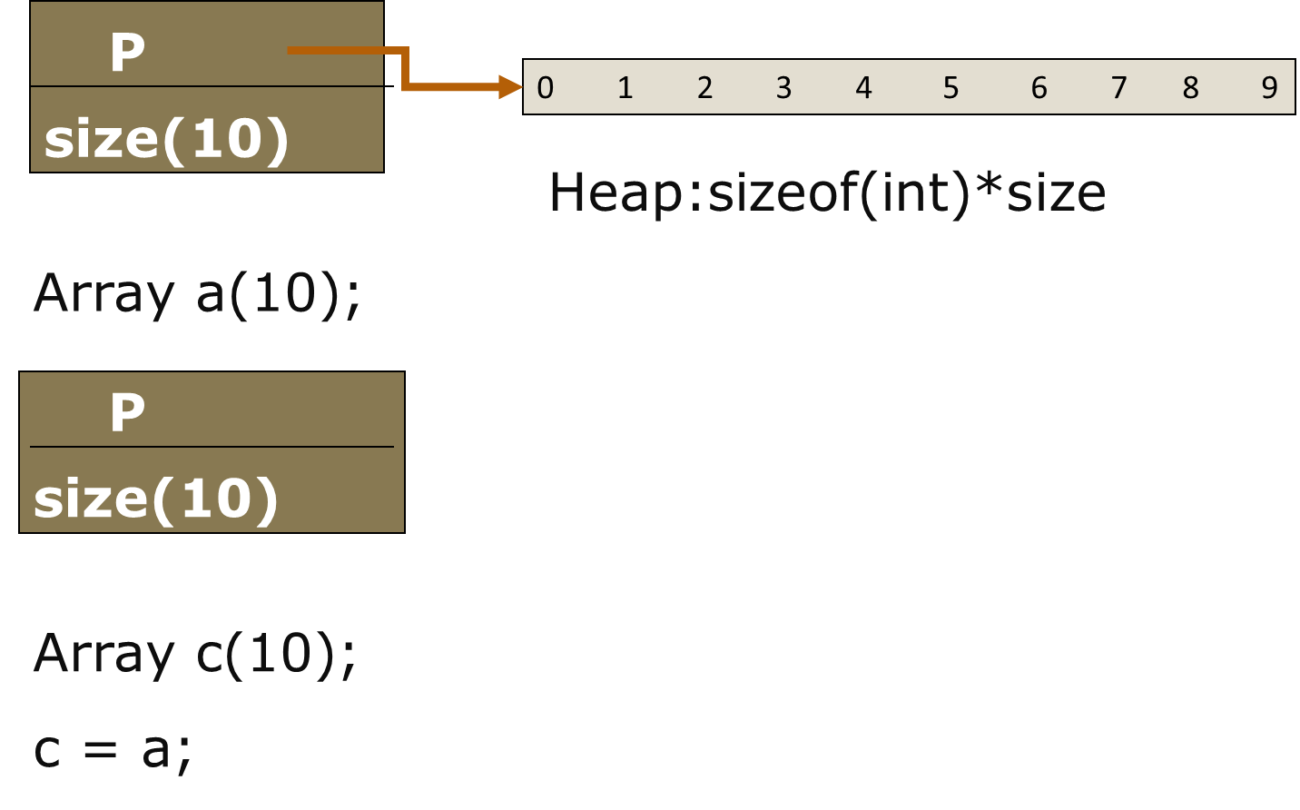

Slide 63
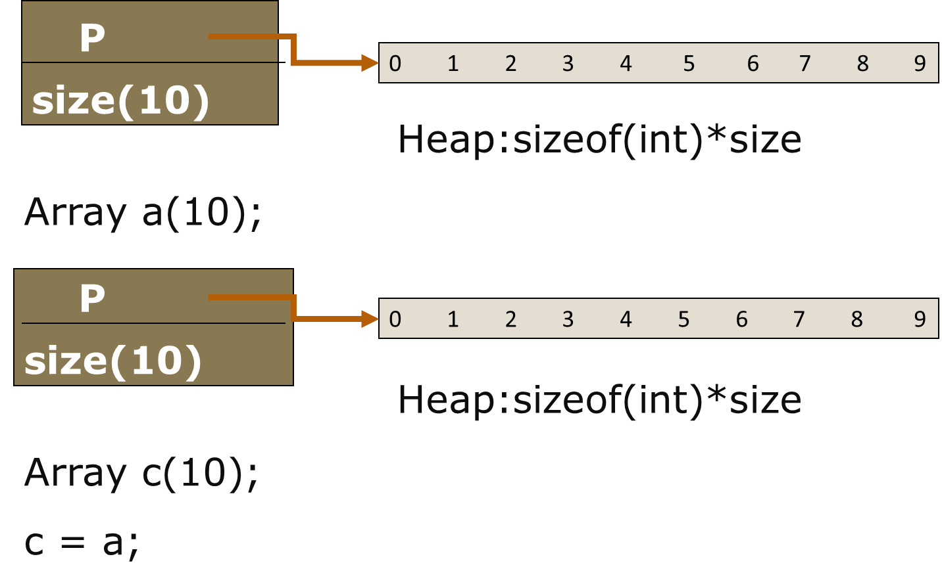

Slide 64
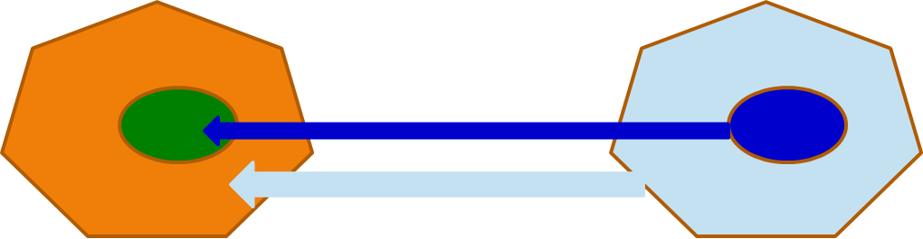
Memberwise
Memberwise Assignment(成员赋值)
if the class contains subobjects (or is inherited from another class), the operator= for those subobjects is called recursively. This is called memberwise assignment.
Handle assignment to self in operator=

Slide 65
Copy constructor VS operator=
拷贝构造函数和赋值函数非常容易混淆，常导致错写、错用。拷贝构造函数是在对象被创建时调用的，而赋值函数只能被已经存在了的对象调用。
String a(“hello”);
String b(“world”);
String c = a; // 调用了拷贝构造函数，最好写成 c(a);
c = b; // 调用了赋值函数
本例中第三个语句的风格较差，宜改写成String c(a) 以区别于第四个语句。

Slide 66
【规则】尽可能使用编译器隐式生成的函数
编译器生成缺省函数时，产生优良代码。这种代码通常比用户编写的代码的执行速度快，原因是编译器可以利用汇编级功能的优点，而程序员则不能利用该功能的优点。
缺省函数是内联函数。
-例如: 定义fraction class、conplex class,使用编译器生成的赋值操作，拷贝操作，缺省析构函数。

Slide 67
【规则】为需要动态分配内存的类重载声明拷贝构造函数，析构函数和赋值运算符重载
-只要类里有指针时，就要写自己版本的拷贝构造函数和赋值运算符重载。在这些函数里，你可以拷贝那些被指向的数据结构，从而使每个对象都有自己的拷贝。
-对于有些类，根据实际应用，可以确定程序中不会做拷贝和赋值操作的时候，可以只声明这些函数（声明为private成员）而不去定义（实现）它们。

Slide 68
Overloading new and delete
Overloading global new and delete
Object *p = new Object; // two things occur.
First, storage is allocated using the operator new,
then the constructor is called.
delete p; // two things occur.
First, the destructor is called,
then storage is deallocated using the operator delete.
The constructor and destructor calls are never under your control,

Slide 69
Overloading global new and delete
The constructor and destructor calls are never under your control, but you can change the storage
allocation functions operator new and operator delete.
overloading new & delete for a class
Operator new/GlobalOperatorNew.cpp

Slide 70
Chapter 14 operator overloading
14.1 Introduction
14.2 The Rational Class
14.3 Operator Functions
14.4 Overloading the Subscript Operator []
14.5 Overloading Augmented Assignment Operators
14.6 Overloading the Unary Operators
14.7 Overloading the ++ and –– Operators
14.8 friend Functions and friend Classes
14.9 Overloading the << and >> Operators

Slide 71
The C in C++
3.1 Class
3.2 Composition
3.3 Operator overloading
3.4 Automatic type conversion
3.5 Inheritance
3.6 Polymorphism & Virtual Functions

Slide 72
3.3 Automatic type conversion
abstract data types
Built-in
Other abstract data type
three/cast/cast.cpp

Slide 73
Old style casts
Implicit type conversion
l-value = expression;
Actual parameters --> Formal parameters
Explicit type conversion
l-value = ( type ) expression ;
l-value = type( expression );
扩大转换:从一种类型转换成另一种类型时，如果后者至少能存储和前者相同范围的值，发生的就是“扩大转换”。
收缩转换：如果后者能存储的值的范围小于前者，发生的是“收缩转换”
three/cast/cast.cpp

Slide 74
Explicit Casts should be used carefully, because what you are actually doing is saying to the compiler “Forget type checking – treat it as this other type instead.” That is, you’re introducing a hole in the C++ type system and preventing the compiler from telling you that you’re doing something wrong with a type
int *pi = (int*)i; // not recommended
int *pi = static_cast<int*>(i); //compile-time error！

Slide 75
C++ Style Casts
Standard C++ includes an explicit cast syntax that can be used to completely replace the old C-style casts .
static_cast
dynamic_cast
const_cast
reinterpret_cast

Slide 76
static_cast<T>(v)
将表达式 v 的值转换为 T 类型。该表达式可用于任何隐式允许的转换类型。如果类型转换与旧样式一样合法，则任何隐式转换都可以反向转换。
The static_cast<> operator is more restrictive than the traditional type cast.
For example
enum E { first=1, second=2, third=3 };
int i = second; // 隐式转换
E e = static_cast<E>(i); // 反向隐式转换

Slide 77
const_cast<T>(v)
可用于更改指针或引用的 const 或 volatile 限定符。（在新样式的类型转换中，只有 const_cast<> 可以去掉 const 限定符。）
T 必须是指针、引用的类型。
For example

Slide 78
class A
{
public:
void f();
int i;
};
extern const volatile int* cvip;
extern int* ip;
void use_of_const_cast( )
{
const A a1;
const_cast<A&>(a1).f( ); // 去掉const
ip = const_cast<int*> (cvip); // 去掉 const 和 volatile
}

Slide 79
volatile修饰符告诉编译程序不要对该变量所参与的操作进行优化.在两种特殊的情况下需要使用volatile修饰符:
-第一种情况涉及到内存映射硬件(memory-mapped hardware,如图形适配器,这类设备对计算机来说就好象是内存的一部分一样)。
-第二种情况涉及到共享内存(shared memory,既被两个以上同时运行的程序所使用的内存)。

Slide 80
reinterpret_cast<T>(v)
把数据v以二进制存在的形式，重新解释成另一种类型T的值。reinterpret_cast允许任意的类型装换，包括将指针转换为整数，将整数转换为指针，以及将常量转换为非常量等
For example
int *pi = reinterpret_cast<int*>(i);
将整数i的值以二进制(位模式)的方式被解释为整数指针，并赋给pi
int j = reinterpret_cast<int>(pi);
将指针pi的值以二进制（位模式）的方式被解释为整型，并赋给j

Slide 81
Constructor conversion
If you define a constructor that takes as its single argument an object (or reference) of another type, that constructor allows the compiler to perform an automatic type conversion.
explicit keyword
abstract data types
Built-in
Constructor conversion
three/cast/AutomaticTypeConversion.cpp

Slide 82
complex
double
complex::complex(double d)
{
rpart = d;
ipart = 0.0;
}

Slide 83
“explicit” key word
explicit complex(double rp) : rpart(rp),ipart(0)
{
cout << "I am in complex(double rp)." << endl;
}
c = a + 4; //compile-time error
c = a + complex(4);

Slide 84
Operator conversion
abstract data types
Built-in
operator conversion
three/cast/OperatorConversion.cpp

Slide 85
complex
double
complex::operator double() const
{
return sqrt(rpart*rpart+ipart*ipart);
}

Slide 86
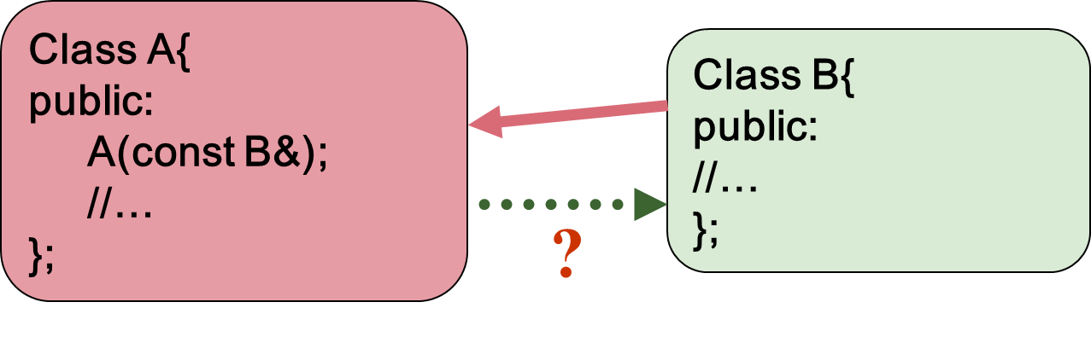
Operator conversion
three/cast/OperatorConversion.cpp

Slide 87
The second way to produce automatic type conversion is through operator conversion. You can create a member function that takes the current type and converts it to the desired type using the operator keyword followed by the type you want to convert to. This form of operator overloading is unique because you don’t appear to specify a return type – the return type is the name of the operator you’re overloading.

Slide 88
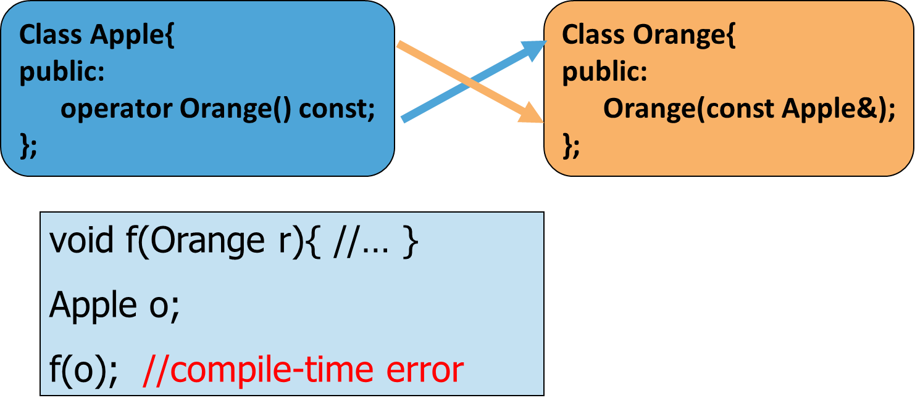
实现自动类型转换要注意的问题：二义性

Slide 89
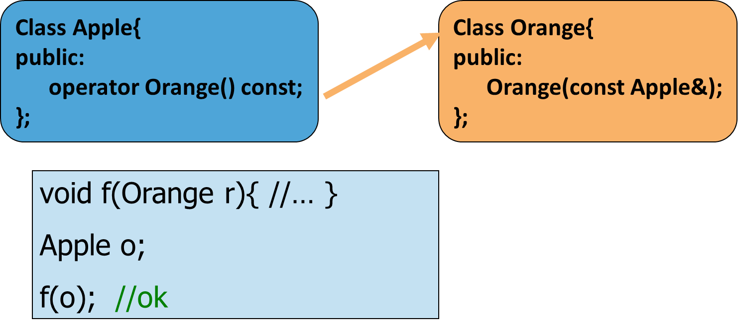
实现自动类型转换要注意的问题：二义性
Solution ：Just provide a single path for automatic conversion from one type to another

Slide 90
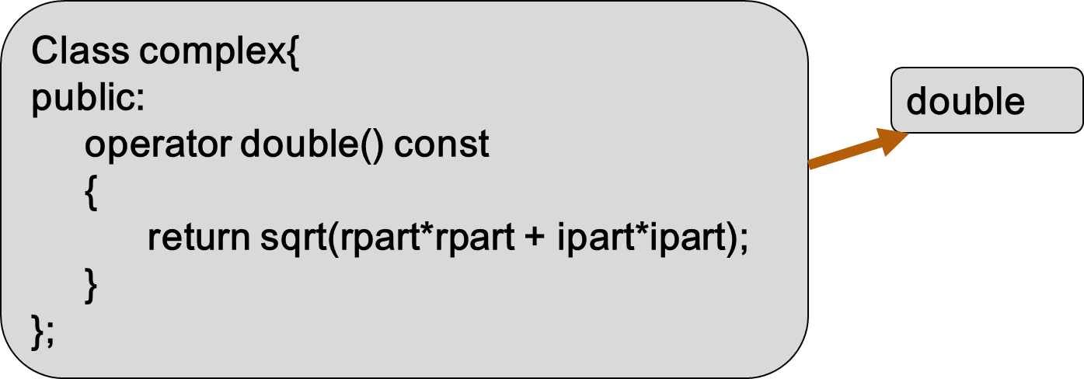
如果要实现从用户定义类型向内置类型转换，必须使用Operator conversion
友员函数版_complex

Slide 91
Chapter 14 operator overloading
14.10 Automatic Type Conversions

Slide 92
提高程序性能
尽量使用引用(&)传递对象
恰当使用inline函数
避免匿名(临时)对象
使用The return optimization(返回效率)

Slide 93
避免匿名(临时)对象
在代码中真正的临时对象是看不见的，它们不出现在你的源代码中。这种未命名的对象通常在两种条件下产生：为了使函数成功调用而进行隐式类型转换和函数返回对象时。理解如何和为什么建立这些临时对象是很重要的，因为构造和释放它们的开销对于程序的性能来说有着不可忽视的影响。
通常有两个方法可以消除它。一种是重新设计你的代码，不让发生这种类型转换。另一种方法是通过修改软件而不再需要类型转换。

Slide 94
在代码中，临时对象的创建和销毁会占用很多处理时间和内存。您编写的函数要将临时对象的数目减少到理解程序所需的最小数目。这些技术包括：
使用显式变量而不使用隐式临时对象；使用引用参数而不使用值参数；使用返回值优化技术；另外一种技术是实现和使用诸如 += 这样的操作，而不实现和使用只包含 + 和 = 的操作。例如，下面的第一行引入了 a + b 结果的临时对象，而第二行则不是。 complex x = a + b ；
complex x( a ) ； x += b ；

Slide 95
Code analysis
-首先， temp对象被创建，与此同时它的构造函数被调用。
-然后，拷贝构造函数把temp拷贝到返回值外部存储单元(匿名对象)。
-最后，当temp在作用域的结尾时调用析构函数。
const complex operator+( const complex& x, const complex& y) { complex temp(x.rpart + y.rpart, x.ipart + y.ipart);
return temp;
}

Slide 96
Code analysis
c = a + b; 匿名对象赋值给c，然后调用析构函数释放匿名对象
const complex operator+( const complex& x, const complex& y) { complex temp(x.rpart + y.rpart, x.ipart + y.ipart);
return temp;
}

Slide 97
The return optimization(返回效率)
Code analysis
-编译器直接地把这个对象创建在返回值外部内存单元。因为不是真正创建一个局部对象，所以仅需要带参构造函数调用（不是拷贝构造函数），效率提高了。
The return optimization
const complex operator+( const complex& x, const complex& y) {
return complex(x.rpart+y.rpart,x.ipart+y.ipart);
}

Slide 98
The C in C++
3.1 Class
3.2 Composition
3.3 Operator overloading
3.4 Automatic type conversion
3.5 Inheritance
3.6 Polymorphism & Virtual Functions

Slide 99
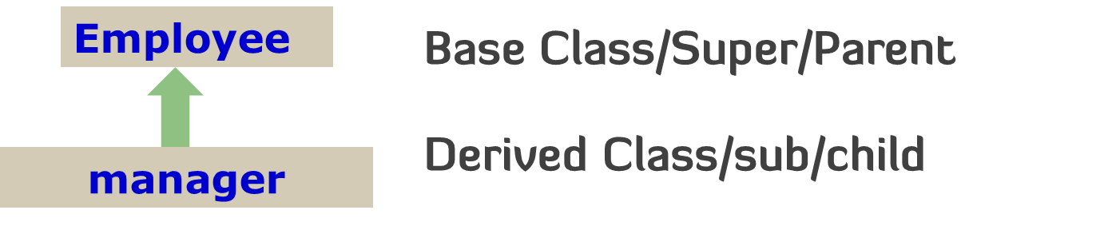
Inheritance
Inheritance: A mechanism express a particular layer of the objects and other objects.
Automatic inherit the father operations and datas
support incremental development
Unit three/employee

Slide 100
Incremental development
program development is an incremental process, just like human learning. inheritance support incremental development by allowing you to introduce new code without causing bugs in existing code. A base type contains all of the characteristics and behaviors that are shared among the types derived from it. You create a base type to represent the core of your ideas about some objects in your system. From the base type, you derive other types to express the different ways that this core can be realized.

Slide 101
继承的优点之一是它支持渐增式开发，它允许我们在已开发的代码中引进新代码，而不会给源代码带来错误，即使产生了错误，这个错误也只是与新代码有关。也就是说当我们继承已存在的功能类并对其增加数据成员和成员函数（并重定义已存在的成员函数）时，已存在类的代码并不会被改变，更不会产生错误。
如果出现错误，我们就会知道它肯定在我们的新代码中。相对于修改已存在代码体的做法来说，这些新代码很短也很容易读。
认识到程序开发是一个渐增过程，就像人的学习过程一样，这是很重要的。我们做尽可能多的分析，但当开始一个项目时，我们仍不可能知道所有的答案。如果开始把项目作为一个有机的、可进化的生物来“培养”，而不是完全一次性的构造它，我们就会获得更大的成功和更直接的反馈。

Slide 102
Inheritance syntax
class derivedClass : public baseClass
{ //difference parts between base and derived；
} ；
①Adding data members and member functions
②Redefining existing member functions during inheritance

Slide 103
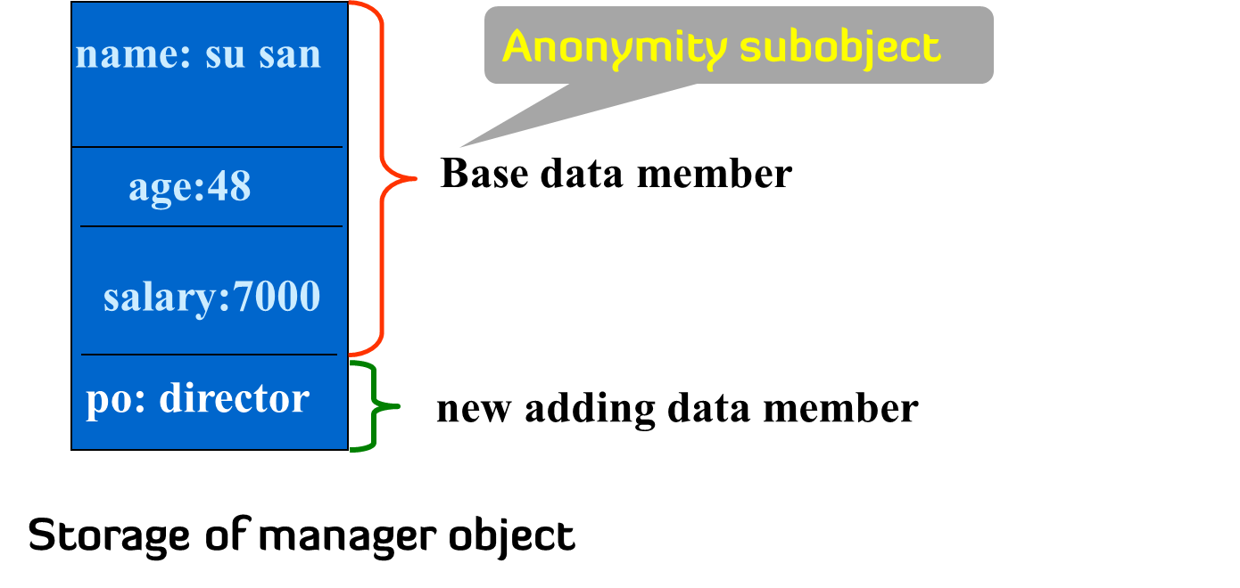
manager m(“su san”, 48, 7000, “Director”);

Slide 104
Constructor and Destructor of the derived class
When an object is created, the compiler guarantees that constructors for all of its subobjects are called.
，The solution is simple: Call the constructor for the subobject. C++ provides a special syntax for this, the constructor initializer list.

Slide 105
class C : public A //father Anonymity subobject
{ private:
B m； //guest member subobject
int i;
};
C(parameter list1 declarations,
parameter list2 declarations,
parameter list3 declarations) ： A(parameter list1 ),
m(parameter list2 )
{//initialize parameter list3；}

Slide 106
class C : public A //father Anonymity subobject
{ private:
B m； //guest member subobject
int i;
};
C(parameter list1 declarations,
parameter list2 declarations,
parameter list3 declarations) ： A(parameter list2 ),
m(parameter list1 )
{//initialize parameter list3；}

Slide 107
Order of constructor
First subobject father→
then guest subobject→
finally myself
Order of destructor
Finally father←then guest←first myself

Slide 108
Order of constructor & destructor calls
construction starts at the very root of the class hierarchy, and that at each level the base class constructor is called first, followed by the member object constructors. The destructors are called in exactly the reverse order of the constructors.
the order of constructor calls for member objects is completely unaffected by the order of the calls in the constructor initializer list. The order is determined by the order that the member objects are declared in the class.
Unit three/Inheritance/Order.cpp

Slide 109
Automatic destructor calls
-there’s only one destructor for any class, and it guaranteed clean up for their particular class . you never need to make explicit destructor calls
-the compiler ensures that all destructors are called, and that means all of the destructors in the entire hierarchy, starting with the most-derived destructor and working back to the root.

Slide 110
设计一个派生类需特别关注的地方
在继承层次中构造函数和析构函数的行为
默认构造函数（无参构造函数）的重要性
析构函数的调用时机
当对象被创建和销毁时，处理内存的方式

Slide 111
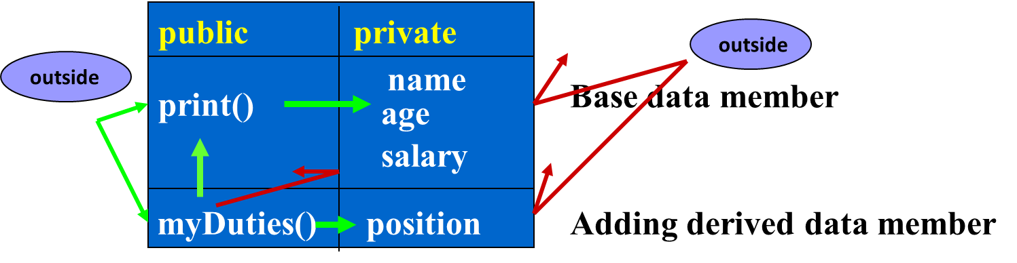
Protected Access protection

Slide 112
Access Protection
Public Member
visible to self and all clients
Protected Member
visible to self and classes derived from self and to friends
Private Member
visible only to self and to friends!

Slide 113
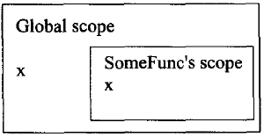
Name hiding
In C
int x; //global variable
void someFunc()
{
double x; //local variable
x = 100;
::x = 200;
}
Unit three/Inheritance/NameHide.cpp

Slide 114
In C++，在派生类中，重定义（redefine）或重载（overriding）基类的一个函数，派生类函数会掩盖所有基类版本，“本地优先”
//In parent
void parent::f(int a);
int parent::f(int a , double d);
void parent::f(char c);
//In child
void child::f(int a); //redefine,name hiding
void child::f(double a); //overriding,name hiding

Slide 115
Name hiding --
Avoid hiding inherited names

Slide 116
Functions that don’t automatically inherit
Not all functions are automatically inherited from the base class into the derived class. Constructors and destructors deal with the creation and destruction of an object, and they can know what to do with the aspects of the object only for their particular class, so all the constructors and destructors in the hierarchy below them must be called. Thus, constructors and destructors don’t inherit and must be created specially for each derived class.
①constructor
②destuctor
③overloading operator new
④assignment operation =
⑤friend relation

Slide 117
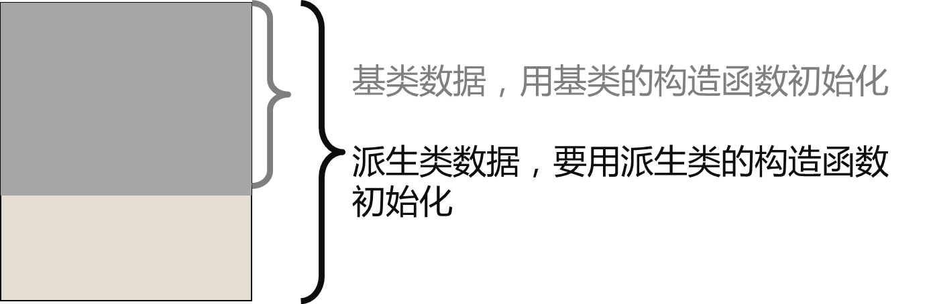

Slide 118
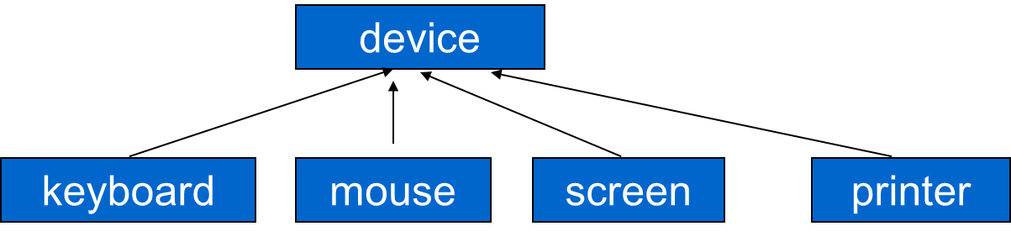
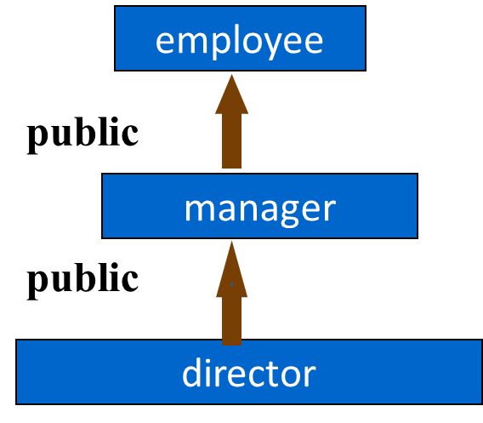
Inheritance hierarchy
one class can derive many subclass。One subclass can derive continually sub-subclass……
在继承中，派生类几乎继承了基类的所有特征，因而在定义一组类时，将其公共属性抽取出来，放在基类中，就可以避免在每个类中重写基类的代码。在派生类中利用重定义函数修改基类行为进一步增加了重用的灵活性，为重用带来了方便。

Slide 119
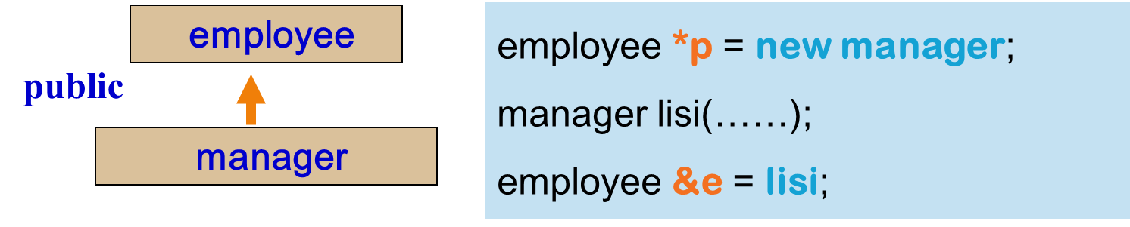
Upcasting
The act of converting from a Derived reference or pointer to a base class reference or pointer.
-A base pointer can points self and the derived obejct.
-A base reference can refers to self and the derived object.
unit three/upcasting/upcast.cpp

Slide 120
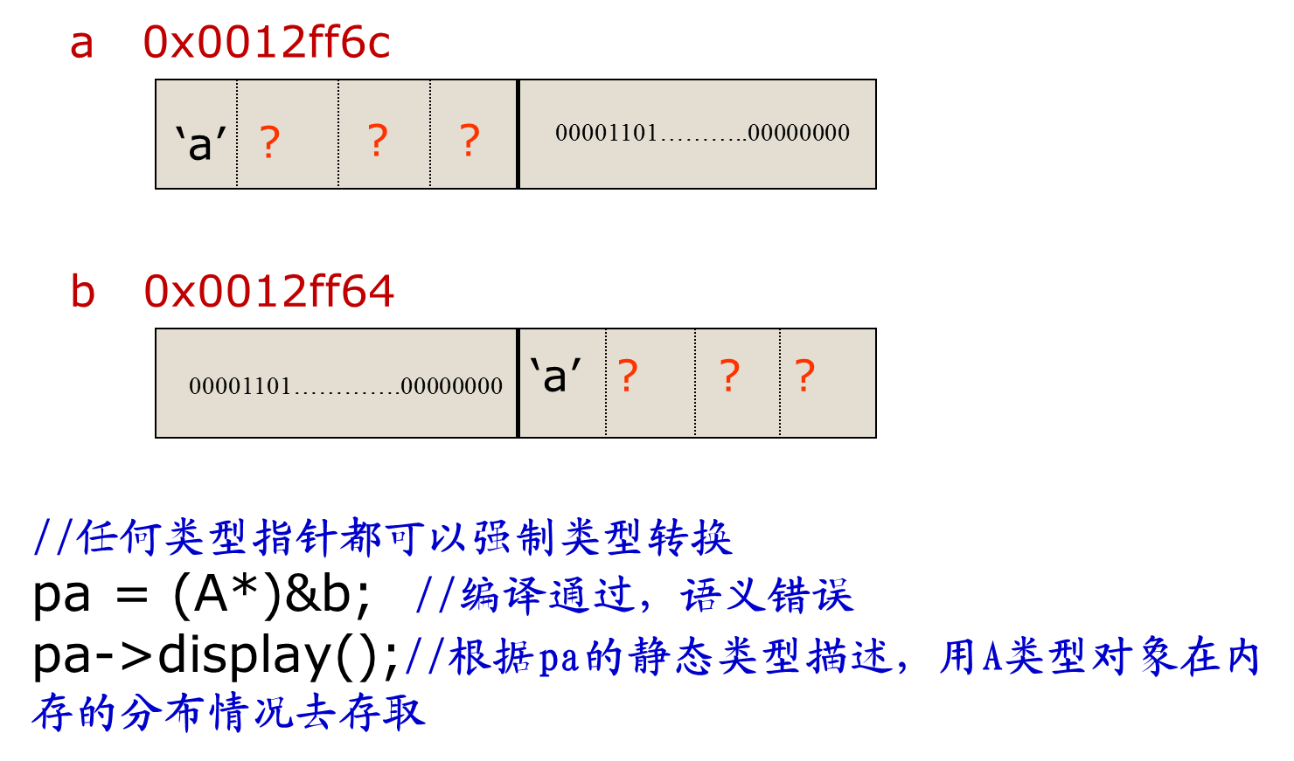

Slide 121
Upcasting
Upcasting-- syntax is correct and semantics is correct too!!

Slide 122
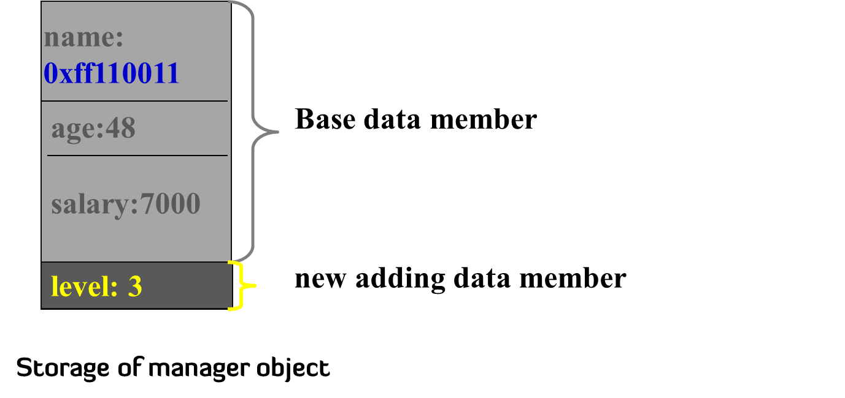
Upcasting-Grammatically correct
manager ss(“su san ”, 48, 7000, 3);
employee *pe;
pe = &ss; // upcasting
基类匿名子对象的数据成员分配大小与顺序与基类对象一样
unit three/upcasting/upcastIninheritance.cpp

Slide 123
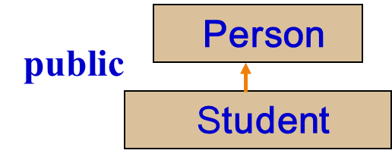
Upcasting-Semantically correct
void eat(const Person *pe); // anyone can eat
void study(const Student *ps); // only students study
Person wang; // wang is a Person
Student chen; // chen is a Student
eat(&wang); // fine, wang is a Person
eat(&chen); //upcasting, fine, chen is a Student,
// and a Student is-a Person
study(&chen); // fine
study(&wang); // error! wang isn't a Student

Slide 124
void eat(const Person &pe); // anyone can eat
void study(const Student &ps); // only students study
Person wang; // wang is a Person
Student chen; // chen is a Student
eat(wang); // fine, wang is a Person
eat(chen); //upcasting, fine, chen is a Student,
// and a Student is-a Person
study(chen); // fine
study(wang); // error! wang isn't a Student

Slide 125
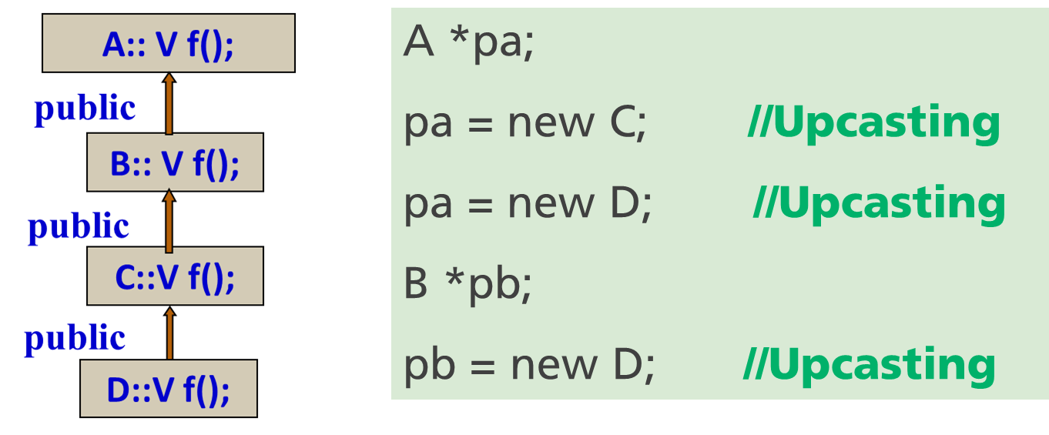
Upcasting
A base pointer(or base reference) can points(reference) self and the derived obejct in public inheritance

Slide 126
manager ss(“su san ”, 48, 7000, 3);
employee *pe;
pe = &ss; // upcasting
pe->print(); //employee::print()
pe->Salary(); //employee::Salary()
pe->Signing(); //complie-time error

Slide 127
Problem analysis
Suppose: An enterprise there are 1,000 men(several managers from them)，programming to print personal information 。
(1) If Using array
employee a[1000]; //inappropriate
//or
manager a[1000]; //inappropriate

Slide 128
(2)Use pointers array
employee *p[1000];
//p[i] pointed {i} personal 0<=i<1000 p[i] = new employee ls("李四",29,2000);
or
p[i] = new manage("张三",29,6000,"科长");
for (i=0; i<1000; i++)
p[i]->print();
The trouble is :
every call employee::print()

Slide 129
employee::
Public: void print();
float salary();
employee *p[1000];
//p[i] pointed {i} personal 0<=i<1000
for (i=0; i<1000; i++)
p[i]->print();
Hoping：when p[i] is pointed employee， calling employee::print();
when p[i] is pointed manager，
calling manager::print()
manager::
Public: void print();
float salary();

Slide 130
class derivedClass : [public | protected | private] baseClass
{ //difference parts between base and derived；
} ；
①Adding data members and member functions
②Redefining existing member functions during inheritance

Slide 131
Inheritance
public inheritance
- All the private elements of base are still private in derived, All the public elements of base are still public in derived. All the protected elements of base are still protected in derived.
private inheritance
protected inheritance

Slide 132
Private inheritance
- All the elements(public、private、protected) of base are private in derived
Protected inheritance
-All the private elements of base are still private in derived. All the public and protected elements of base are protected in derived.

Slide 133
基类成员对派生类都是：公有和保护的成员是可见的，私有的的成员是不可见的。
基类成员对派生类的对象来说：要看基类的成员在派生类中变成了什么类型的成员。如：私有继承时，基类的共有成员和私有成员都变成了派生类中的私有成员，因此对于派生类中的对象来说基类的共有成员和私有成员就是不可见的。
 | public | protected | private
public inheritance | public | protected | 不可见
Private inheritance | private | private | 不可见
Protected inheritance | protected | protected | 不可见

Slide 134
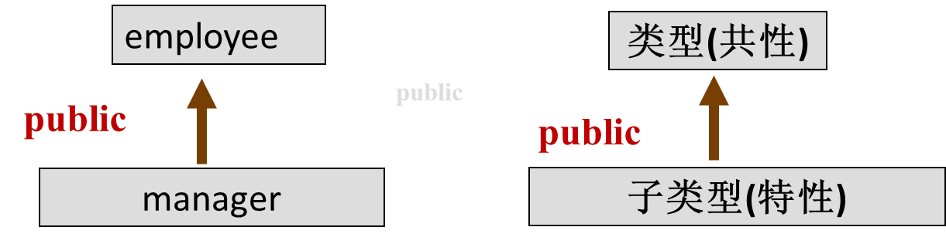
When to use public inheritance?
Make sure public inheritance models "is-a“
作为一种设计技术， 公有继承揭示了应用域概念之间的语义关系。从应用域角度而言，抽象之间的语义关系是特殊与一般的关系，或称IS-A关系。在这种关系中，描述特殊性的类是子类（父类的特化）。相反，父类描述一般性，被称为子类的泛化。从类型角度而言，这种语义关系是子类型关系，即一个子类型所定义的对象集合是一个父类型所定义的对象集合的一个子集。

Slide 135
使用于base classes身上的每一件事情一定也适用于derived classes身上。

Slide 136
若在逻辑上B是A的“一种”（a kind of ），则允许B继承A的功能和属性。例如男人（Man）是人（Human）的一种，男孩（Boy）是男人的一种。那么类Man可以从类Human派生，类Boy可以从类Man派生。
class Human{//…};
class Man: public Human{//…};
class Boy: public Man{//…};
如果类A和类B毫不相关，不可以为了使B的功能更多些而让B公有继承A的功能和属性。

Slide 137
公有派生体现了从普遍到特殊的过程，子类对象和父类对象的之间的(语义)关系是：普遍跟特殊的关系(IS_A)。
多层次继承反映了从抽象到具体的思维过程。当我们为基类定义一部分特征后，通过派生，不断加入新特征，最终获得所需要的类。
在具体设计类时，要选好各个抽象层比较是比较困难的。需要积累的经验和专门的方法（《软件工程》）。判断两个类之间是否可以使用公有继承的办法之一是使用“in kind of”

Slide 138
When to use private inheritance?
Private mean: all of the members(including public and private and protected) of the base class would be private in the derived class. you’re creating a new class that has all of the data and functionality of the base class, but that functionality is hidden, so it’s only part of the underlying implementation.
unit three\ private inheritance

Slide 139
私有继承的含义不是 “是一个”，如果使类D私有继承于类B，这样做是因为你想利用类B中已经存在的某些代码，而不是因为类型B的对象和类型D的对象之间有什么概念上的关系。因而，私有继承纯粹是一种实现技术。
three/ private inheritance/组合方法

Slide 140
Private inheritance VS composition
“is-implemented-in-terms-of(根据某物实现出)” 这一事实可以用“私有继承”和“分层” 来实现，怎么在二者之间进行选择呢？答案很简单：尽可能地使用分层，必须时才使用私有继承。什么时候必须呢？《Effective C++》条款42: 明智地使用私有继承
奇异现象减少。子类从一个父类继承后，与父类在同一名字空间中的函数或函数模板的名字查找变得非常复杂，难以调用。
更广的适用性。有些类一开始并不是想设计成基类，但大多数类都能充当一个成员的角色。
更健壮、更安全。继承的较强耦合性命名编写没有错误的安全代码更加困难。
复杂性和脆弱性降低。继承会带来额外的复杂性情况，如名字隐蔽。因此，使用组合通常比使用继承更适宜，努力做到只在“is-a”的情况下才用继承。

Slide 141
The C in C++
3.1 Class
3.2 Composition
3.3 Operator overloading
3.4 Automatic type conversion
3.5 Inheritance
3.6 Polymorphism & Virtual Functions

Slide 142
3.5 Polymorphism & Virtual Functions
Polymorphism
-Function overloading
-Operator overloading
-Polymorphic pointer(or reference)
-in public inheritance, base pointer(or reference) can points self and derived objects ，dynamic polymorphism
Static Polymorphism

Slide 143
class employee{
public: virtual void print();
virtual float salary();
};
Virtual function
class manager : public employee{
public: virtual void print();
virtual float salary();
};
employee* p = new employee("zhangsan",30,3500);
p->print(); //call employee::print()
p = new manager("lisi",35,4500,3);
p->print(); //call manager::print()

Slide 144
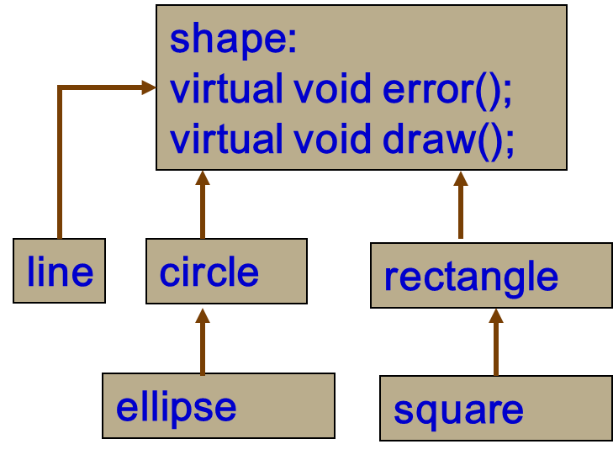
shape *p;
p = new line(……);
p->draw(); /*call line::draw()*/
p = new circle(……);
p->draw(); /*call circle::draw()*/

Slide 145
Dynamic binding
in public inheritance, base pointer(or reference) can points derived objects
by the pointer(or reference) calling a virtual function
unit three\ Polymorphism\ dynamic binding

Slide 146
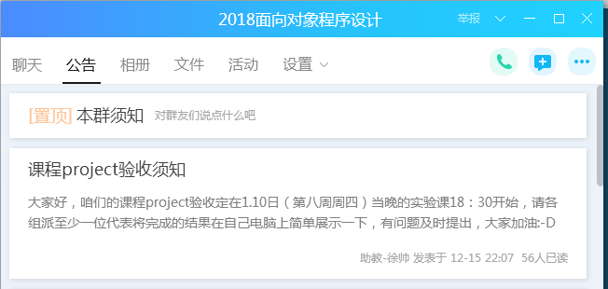
Project 期末验收通告
组成员必须全部到场！！

Slide 147
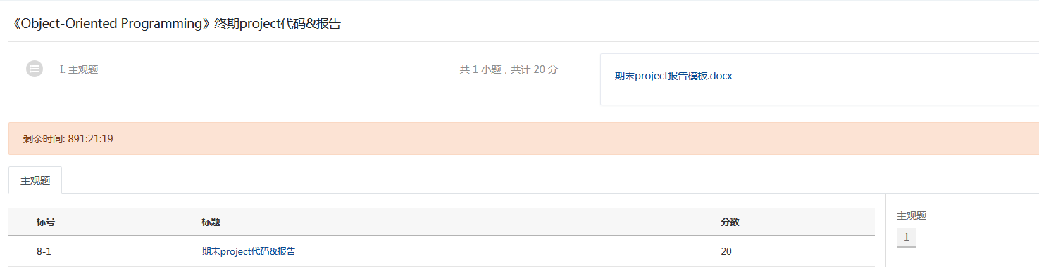

Slide 148
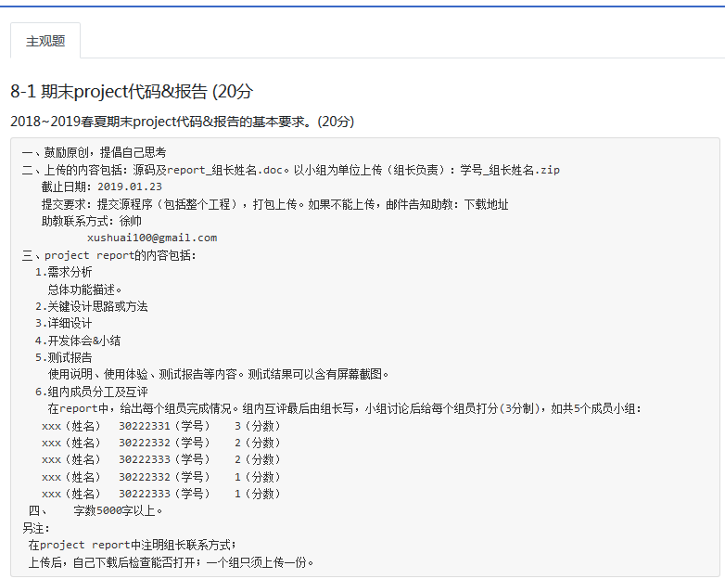

Slide 149
virtual function VS non-virtual member function
non-virtual member function: 基类提供实现，派生类继承接口和实现。
virtual function: 基类与派生类有同名操作（继承接口），派生类可以有自己的实现，也可以没有。
每个派生类都可以支持一个“当遇上错误时可调用”的函数，每个派生类可自由处理错误。
如果某个派生类不想针对错误做出任何特殊行为，它可以退回到基类shape提供的缺省错误处理行为。
class shape{
public: int objectID() const;
virtual void error() const;
};
class Rectangle : public shape{
public: virtual void error() const;
};
class Ellipse : public shape{
public:
};
unit three\ Polymorphism\ virtual function

Slide 150
class employee{
public: virtual void print();
virtual float salary();
};
根据语义环境，派生类manager必须有自己的print()操作和salary()。
class manager : public employee{
public: virtual void print();
virtual float salary();
};

Slide 151
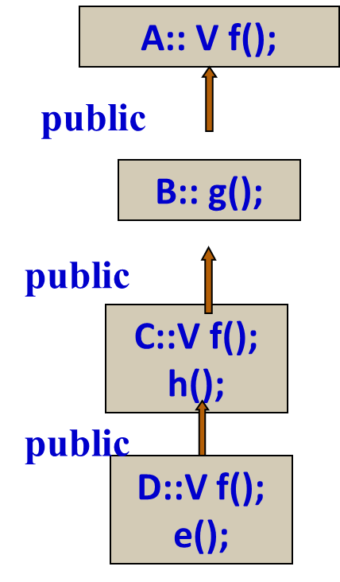
A *pa;
pa = new C;
pa->f(); // dynamic binding ,call C::f()
pa = new B;
pa->f(); // dynamic binding ,call A::f()

Slide 152
virtual destructor function
Constructor can’t be Virtual
Destructor is often virtual function –
virtual destructor function
编译器自动生成的析构函数不是虚函数
unit three\ Polymorphism\ virtual destructor.cpp

Slide 153
How C++ implements dynamic binding (late binding)?
All the work goes on behind the scenes by the compiler, which installs the necessary late-binding mechanism when you ask it to (you ask by creating virtual functions).
To accomplish this, the typical compiler creates a single table (called the VTABLE) for each class that contains virtual functions. The compiler places the addresses of the virtual functions for that particular class in the VTABLE.

Slide 154
In each class with virtual functions, it secretly places a pointer, called the vpointer (abbreviated as VPTR), which points to the VTABLE for that object.
The compiler secretly inserts code into the beginning of the constructor that initializes the VPTR.

Slide 155
when you make a polymorphic call, the compiler quietly inserts code to fetch the VPTR and look up the function address in the VTABLE, thus calling the correct function and causing late binding to take place.
C++编译器为每个包含虚函数的类生成一个虚函数表(VTABLE)，每个虚函数表中存储有相应的虚函数地址。当建立该类的一个对象时，对象中含有一个隐含的指针(vpointer)数据成员，该指针指向该类的虚函数表。该指针数据成员由C++编译器自动为这个类定义并在构造函数中初始化。

Slide 156
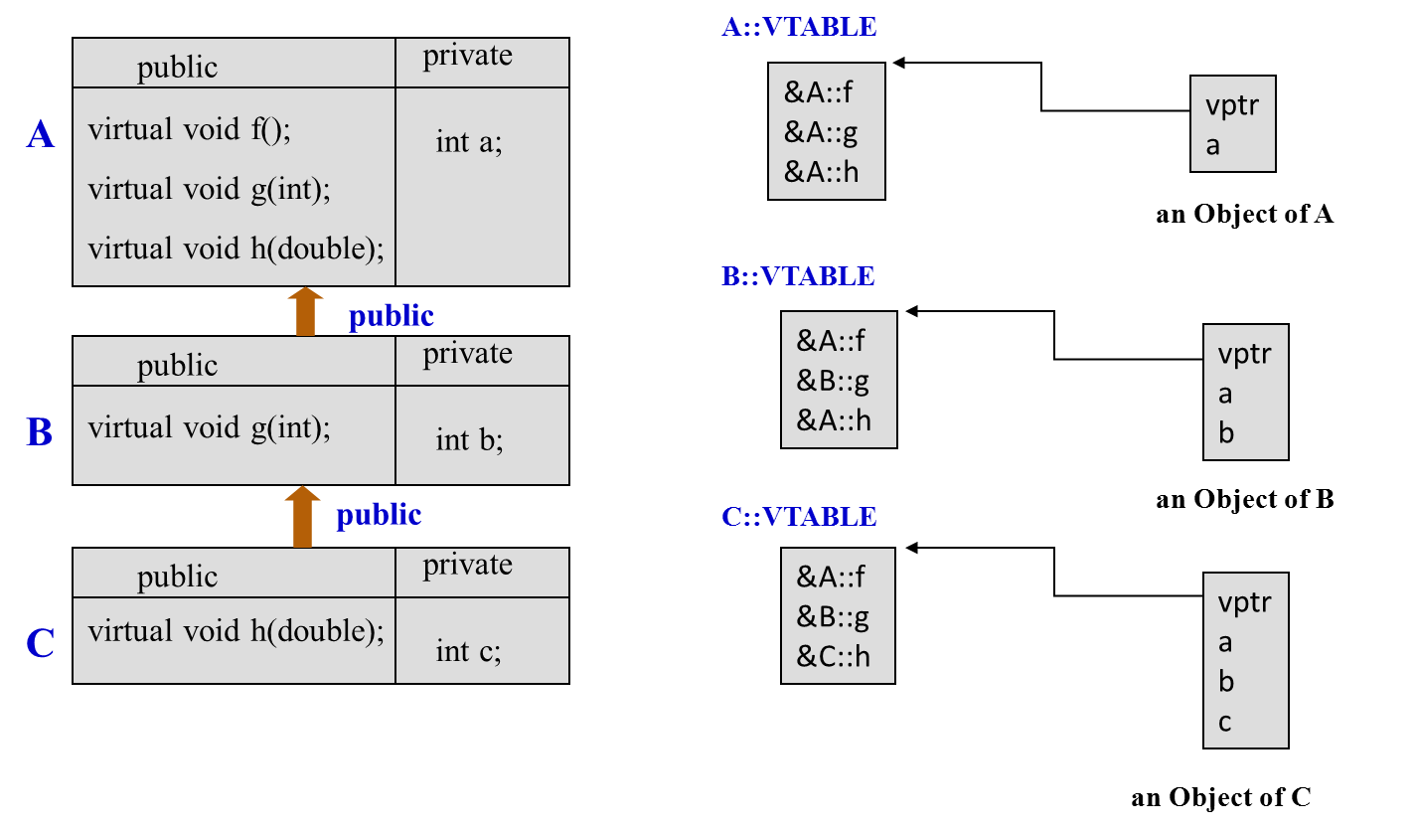

Slide 157
A * p = new C; //….
p->h(5);
//due to h() is a virtual function，when compiling generate:
( vptr [ 2 ] )( p , 5 );
When program runtime ，if p points an object of B，call A::h()；if points an object of C, call C::h()an object of C，call C::h()。

Slide 158
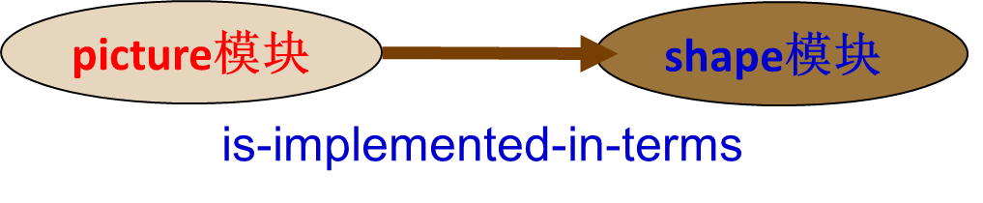
Benefits of using virtual functions
Independence
picture模块只操纵shape基类，具体类的draw()操作由编译器选择，这时，picture模块需要了解的只是shape基类，它不与shape组的其它模块有关。即picture与line、circle、rectangle、square等相互独立。
在开发程序时，只要指定了shape基类的接口。可以把picture模块和shape模块各个不同的小组开发。开发过程中，不必协调交换相互之间的信息，任何一方的任何变动都不相互影响。
OOP/MiniCAD

Slide 159
Independence
Information hiding
Extensibility
-you can add as many new types as you want without changing the base class(shape module) and other program(picture module).

Slide 160
Independence
Information hiding
Extensibility
Maintenance
防止组合爆炸
-对象的类型识别工作由程序员来做的话，其工作量是可想而知的。如，
switch(p->get_type()){
case:
case:
}

Slide 161
Independence
Information hiding
-通过构造基类抽象接口而实现信息隐藏。在C++中，信息隐藏体现在：
1)类中private/protected
2)隐藏几个派生类，用基类提供的接口来操纵它们。

Slide 162
使用虚函数的利弊
多态性提高了代码的组织性和可读性。
它使得程序模块间的独立性加强。
增加了程序的易维护性。
它提供了与具体实现相隔离的另一类接口，即把“what”从“how”分离开来 ，即进一步实现信息隐藏。
可使得程序具有可生长性，这个生长性不仅指在项目的最初创建期可“长”，而且希望项目具有新的性能时也能“生长”。
□对于许多语言它是可选的，因为它不是相当高效率的，在程序中设置虚函数既需要额外的代码空间，又需要额外的执行时间。

Slide 163
Parsing code
shape s;
syntax is correct，
But semantic is wrong
unit three\ Polymorphism\ pure virtual functions.cpp

Slide 164
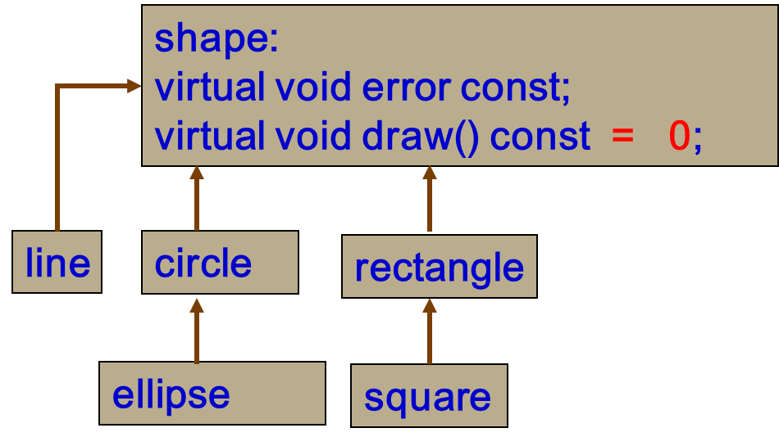
Pure virtual functions and Abstract class
draw() is a pure virtual function
Abstract class, which happens if you give it at least one pure virtual function.
If anyone tries to make an object of an abstract class, the compiler prevents them.
shape s; //compile-time error

Slide 165
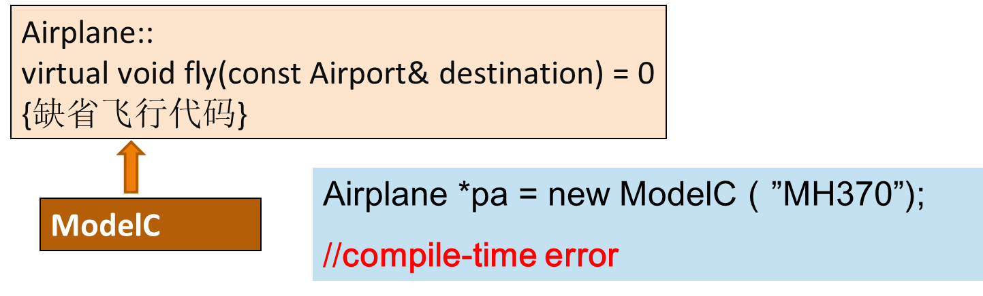
Details of pure virtual function
Pure virtual function
derived class must be redefined（派生类必须重新实现）。

Slide 166
Details of pure virtual function
Pure virtual function
-pure virtual Function of the base class is not implemented
-pure virtual functiogn of the base class is implemented
析构函数不能是纯虚函数

Slide 167
Details of pure virtual function
Pure virtual function
-pure virtual Function of the base class is not implemented
-pure virtual functiogn of the base class is implemented
析构函数不能是纯虚函数
Pure virtual function VS impure function
Abstract class

Slide 168
Project 期末验收通告
组成员必须全部到场！！

Slide 169
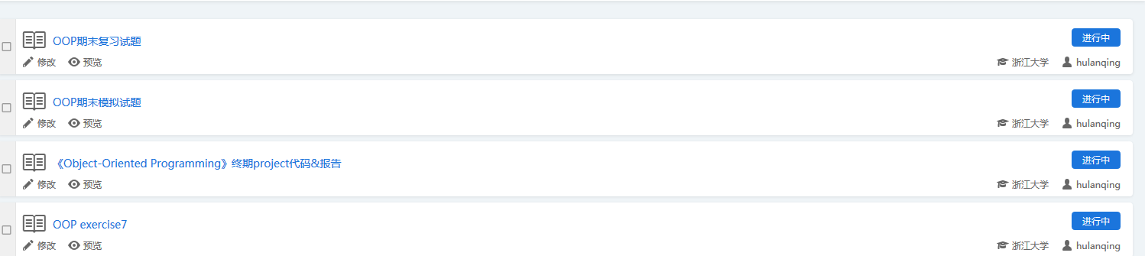

Slide 170
至少含有一个纯虚函数的类__抽象类。
抽象类只能用作其它类的基类。不能创建实例，不能用作函数参数、函数返回类型以及显式转换的类型。
可以声明抽象类的指针和引用，此指针指向派生类对象，实现动态束定。
纯虚函数、空函数、不提供函数体。
如果派生类中没有给出基类的全部纯虚函数的实现代码，它继承基类的这些没有实现的纯虚函数，则派生类还是一个抽象类。
A：： V f() = 0
V g() = 0
public
A a; //×
B b; //×
B：： V f()

Slide 171
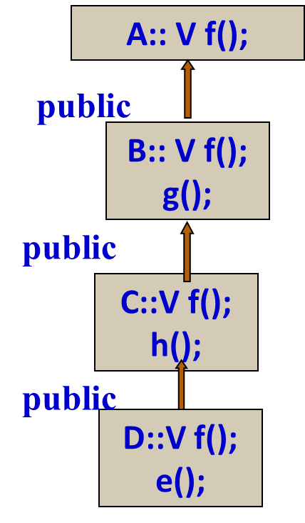
upcasting VS downcasting
Must be in public inheritance hierarchy
Upcasting is always safe, Downcasting is not always safe
A *pa;
pa = new C; //Upcasting
pa->f(); //fine
(C*)pa-> h(); //security
(D*)(pa)->e(); //insecurity
unit three/cast/downcasting.cpp

Slide 172
In downcasting using dynamic_cast
A *pa;
pa = new C; //Upcasting
D *pd = dynamic_cast<D*>(p);
if (pd != NULL)
pd->e();

Slide 173
Special Case
构造函数中的虚函数.cpp
对于在构造函数中调用一个虚函数的情况，被调用的只是这个函数的本地版本。也就是说，虚机制在构造函数中不工作。因为构造函数的工作是把对象变成合理的存在物。在任何构造函数中，对象可能只是部分被形成—我们只能知道基类已被初始化了，如果允许在构造函数中实行虚机制，那么所调用的函数可能操作还没有被初始化的成员，这将导致灾难的发生。
成员函数中的虚函数.cpp
对于普通成员函数中的虚函数的调用是在运行时决定的，这是因为编译时并不能知道这个对象是属于这个成员函数所在的类，还是属于由它派生出来的类。
/Polymorphism/virtual destructor/

Slide 174
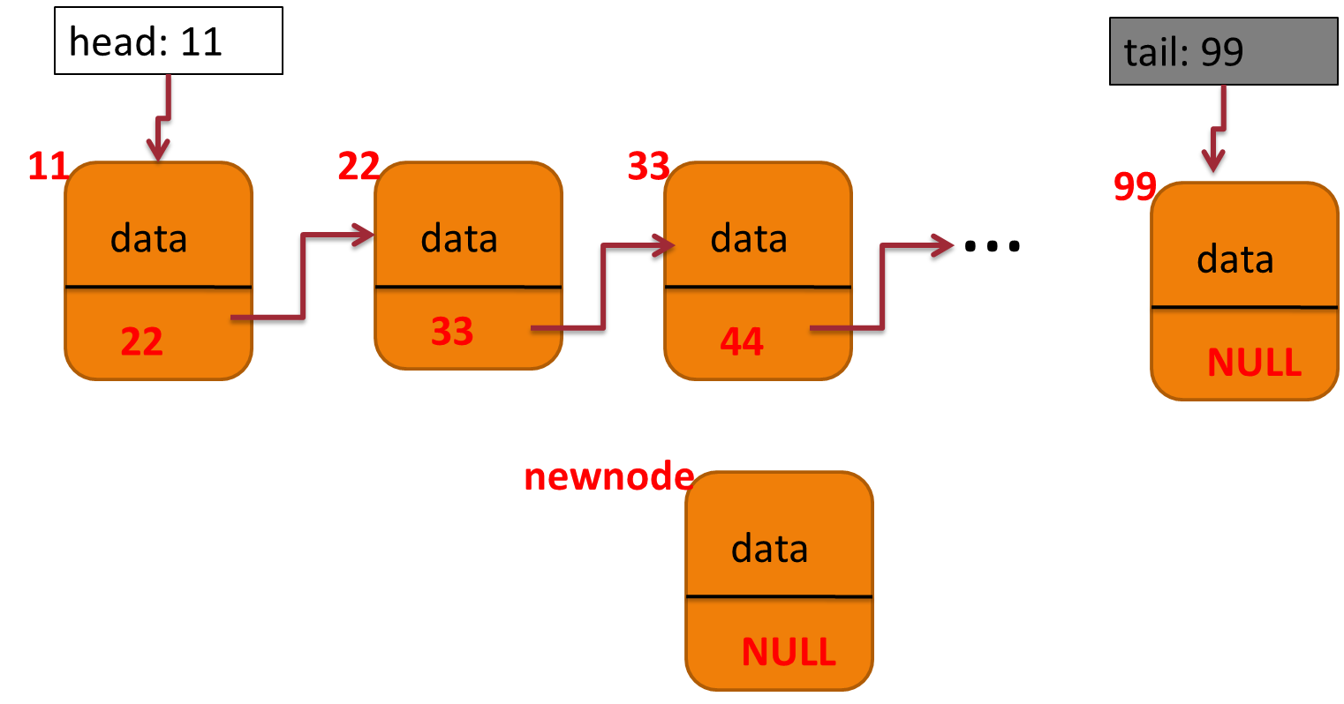
Heterogeneous list
Three/Heterogeneous list/

Slide 175


Slide 176

public:
void linkTo(Node *p);
Node*& next();
virtual ~Node(){}
virtual void print() const = 0;

Slide 177
Chapter 15 Inheritance and Polymorphism
15.1 Introduction
15.2 Base Classes and Derived Classes
15.3 Generic Programming
15.4 Constructors and Destructors
15.5 Redefining Functions
15.6 Polymorphism
15.7 Virtual Functions and Dynamic Binding
15.8 The protected Keyword
15.9 Abstract Classes and Pure Virtual Functions
15.10 Casting: static_cast versus dynamic_cast

